Slide 1
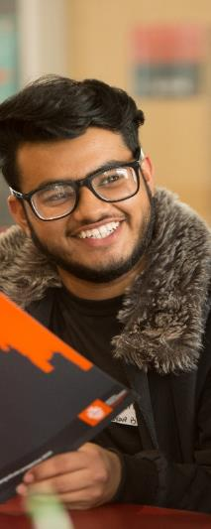


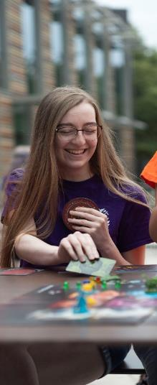
Royal Holloway
Spring University
09-11 April 2025

Slide 2
What?
Who?
Why?
Where?
When?

Slide 3

What?
3 days, 2 nights
Subject taster sessions
Meet current uni students
Lots of social activities
All food provided
Completely free
Notes:
Spread over 3 days and 2 nights, the Spring Residential has 60 places available to students that apply
Students will take part in a variety of subject taster sessions (not only traditional subjects but new ones like Electronic Engineering and Politics & International Relations, as well as ones from other HEON providers such as Farnborough College of Technology)
Our trained student ambassadors who are current students at Royal Holloway will be with us day and night to support students, help them with their visit to us, and be a great source of information about the college and university experience
Throughout the day and in the evenings there will be a variety of social activities to take part in, such as quizzes and movie nights
As well as accommodation, we provide students with breakfast, lunch and dinner, as well as some vouchers to spend on campus
Everything is completely free, and although we cannot guarantee it we will also look to secure extra funds to help support your travel to and from the university

Slide 4
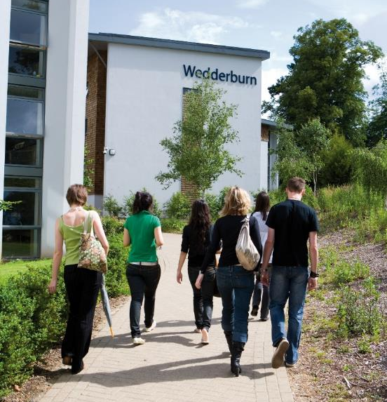
Where?
Royal Holloway
Beautiful Egham campus
Your own private bedroom
Ensuite shower & bathroom
Classrooms & laboratories
Cafes and restaurants
Notes:
The Spring University will take place at Royal Holloway, situated just outside of the M25 in Egham, Surrey
Students will stay on our campus, home to many of our students, which has everything you need, from cafes to classrooms, shops to sports facilities
Staff, student ambassadors, and visiting students will all stay in our flats on campus, everyone in their own private bedroom with double bed, ensuite shower and bathroom
During the day we will visit classrooms and laboratories across campus for interactive taster sessions
For breakfast, lunch and dinner we will all dine together in our campus cafes and restaurants

Slide 5

When?
Arrive 09 April 2025 AM
Leave 11 April 2025 PM
Application deadline:
31 January 2025
Notes:
Students will arrive on campus on the morning of Wednesday 09 April 2025 (not too early, don’t worry!) where we will greet you and your parents/carers if they are dropping you off. We will have student ambassadors across campus to direct those arriving by car, and also located at Egham station if you arrive by train who will walk you to the meet and greet location
On Friday 11 April 2025, after a morning of activities, we will have our closing reception and graduation ceremony. Parents and carers are invited to join us. We will then help everyone to commence their journey home
Students need to apply by 31 January 2025. Applications received after this date might not be considered
Please be aware that these dates fall within the school Easter Holidays, taking place just after the holy month of Ramadan.

Slide 6
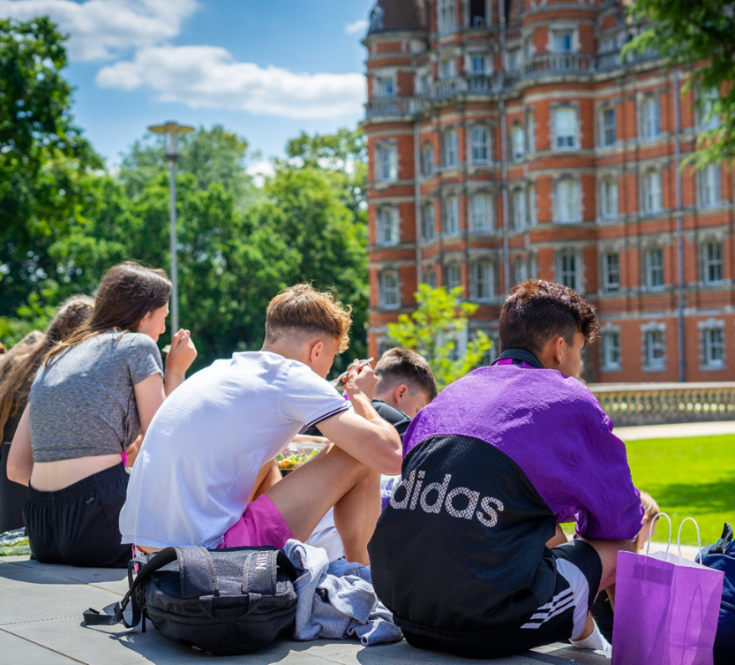
Who?
60 available places
For students from
‘Widening Access’ backgrounds
And us…!
Notes:
There are 60 available places for students who are currently in Years 10 or 11
Students will be selected according to both their applications and to specific ‘widening access’ criteria. This will all be clear on the online application form
And then there’s us…!

Slide 7
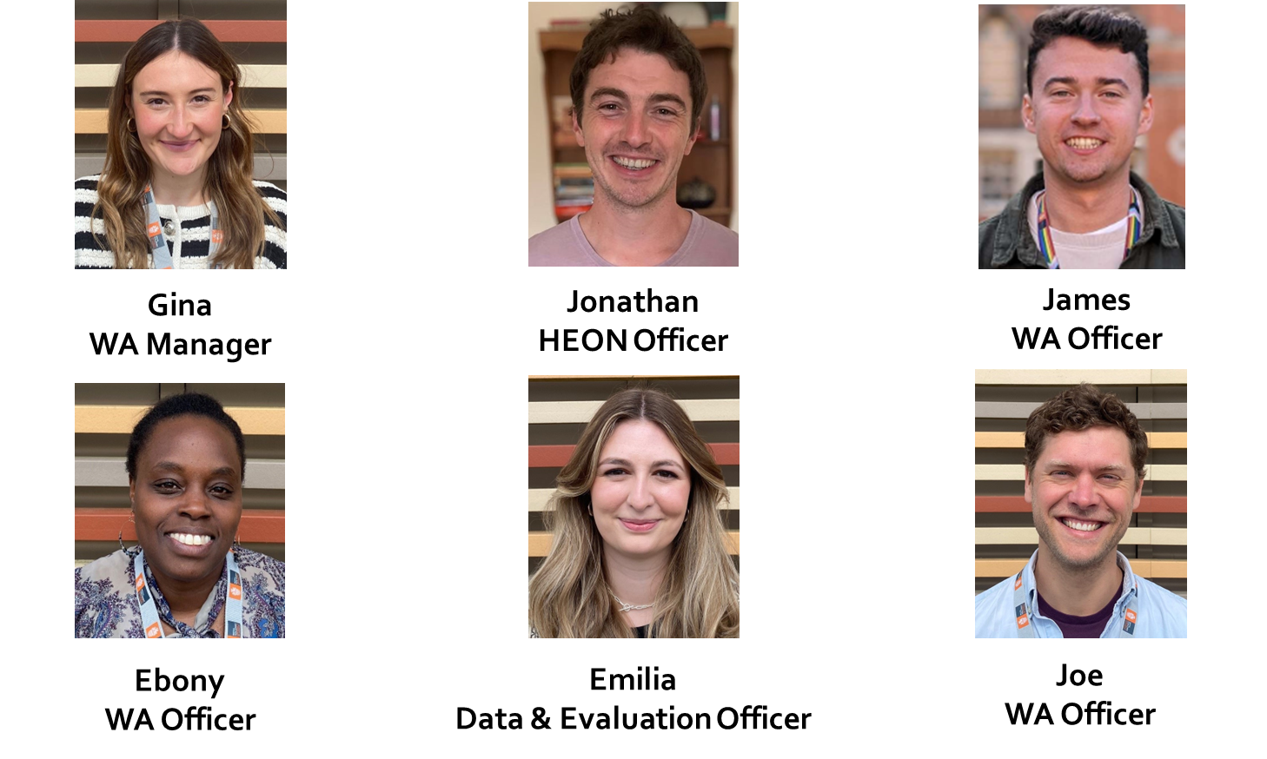
The Widening Access Team
Introductions
Notes:
This is the current Royal Holloway Widening Access team. Jonathan has worked as the Higher Education Outreach Network Officer at Royal Holloway for over six years, and this will be the fourth residential that he has led on. Georgina is our Widening Access Manager and before coming to Royal Holloway she worked in outreach at Reading University. Ebony is our Widening Access Officer, and works mainly in London and Surrey, and has a professional history of working in local governance and sport. James is a Widening Access Officer who has previously worked in the college’s Schools Liaison team and is a graduate of Royal Holloway. Joe is our newest Widening Access Officer having joined us in 2024 from the university’s Accommodation team and, like James, is a Royal Holloway graduate. And finally Emilia is our Data & Evaluation Officer, who makes sure we learn from all of our activities and makes sure that what we do is based on the evidence of our success!
We will also be joined from other members of the HEON partnership, such as the University of Surrey, Farnborough College of Technology, the University for the Creative Arts, and others!

Slide 8
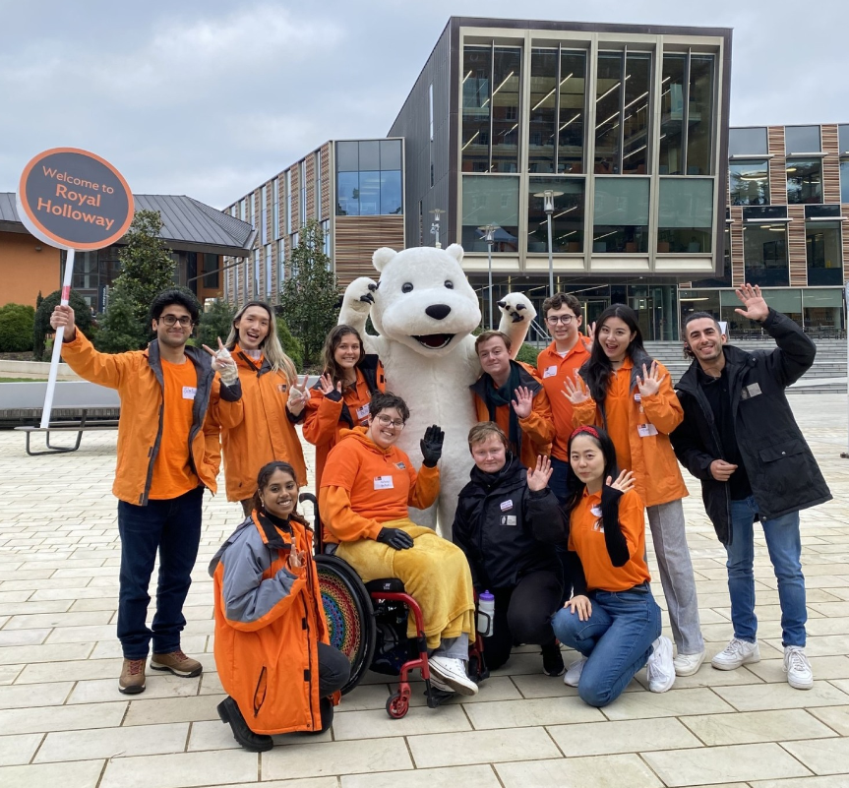
Our Student Ambassadors
Notes:
Joining the WA and HEON teams will be our brilliant student ambassadors, who will be with us day and night to offer their support. From experience the input from student ambassadors is huge, and feedback from visiting students has often shown our ambassadors in a great light. From help in taster sessions, to interesting conversations, to a supportive peer, they ensure that all of our visitors feel welcomed and comfortable

Slide 9
Applications
You will need to include information about yourself, your parents/guardians, and one of your teachers
Be honest, double check your answers, and speak to your teacher and parents/guardians first
For more information on eligibility go to ‘Who can apply?’ on the Spring University webpage
Notes:
Our online application form is found on our Spring University webpage. You can google ‘Royal Holloway Spring University’ or scan the QR code on the final page of this presentation or on our posters
You will need to include info about yourself, parents/guardians, and one of your teachers (who will act as your reference)
You need to be honest and we encourage you to check your answers before submitting. Also speak to your teacher and your parents/guardians prior to your application
For more info please go to ‘Who can apply’ on the Spring University webpage

Slide 10
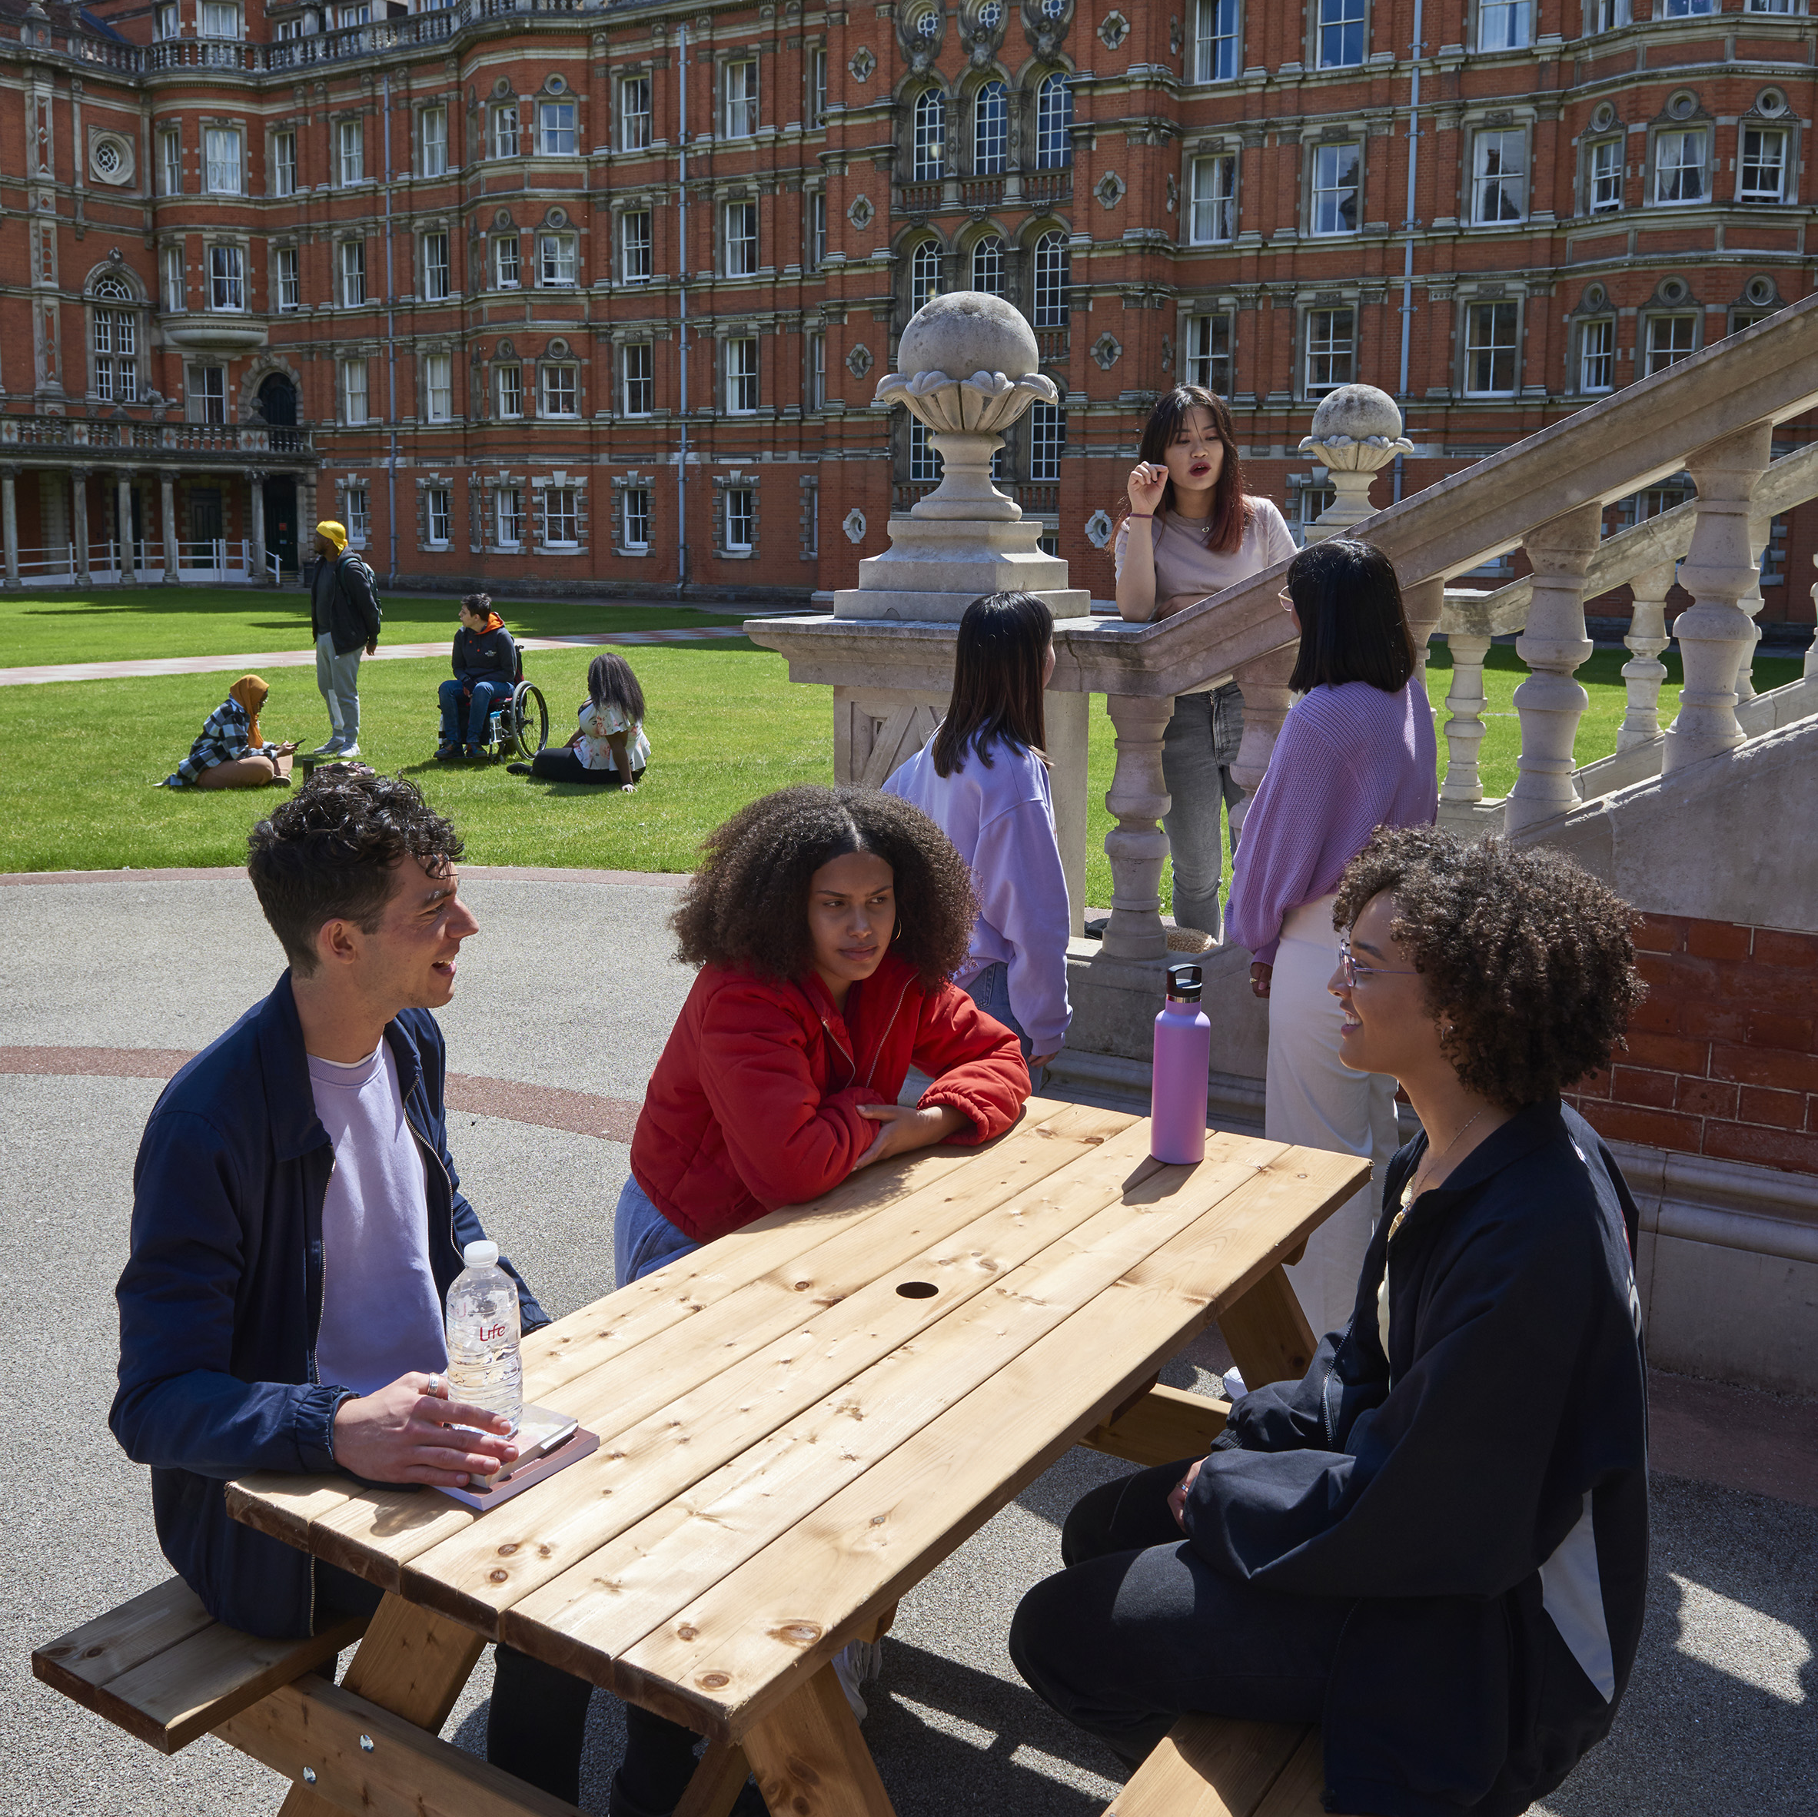
Why?
To have fun!
Meet new people
Have new experiences
Get a feel of what uni is like
Unsure about next steps
See all your options
(& good for CV!)
Notes:
And finally, why should students want to come to Royal Holloway’s Spring University?
First and foremost, it will be fun! And it will be a great chance to meet new people
Students will take part in activities they have never done before and have brand new experiences, including getting to know what life is like as a student in Higher Education
It might also be good for students who are uncertain about what they want to do in the future, and we make sure that we cover a variety of options for students going through FE and HE, not just the university pathway but those that involve training apprenticeships and other vocational routes.
And lastly, this always looks good on a CV and things like college applications!

Slide 11
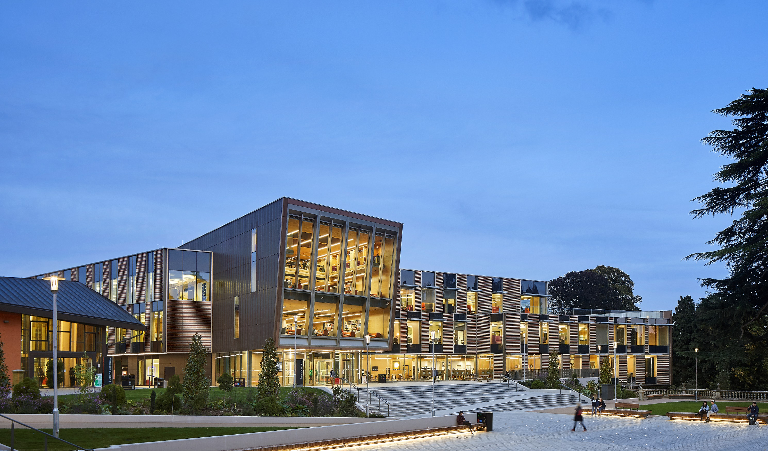




@royal_holloway
@royalholloway
@RoyalHollowayUoL
Spring University: 09 – 11 April 2025
At Royal Holloway
For year 10s and 11s
Scan QR Code for more information
Notes:
Scan the QR code for more information. Please also feel free to send any questions to wa@rhul.ac.uk

